Slide 1






PANTHER SHUTTLE APP
https://yanarex.github.io/shuttle-app-website/
Members: Joseph Hilte, Tony Arrington, Jonathan Suo, and Chase Monigle

Slide 2







Finalize Student Driver
Main Objectives
Ensure a finalized version of both sides were working. (IE: No Placholders)
Implement & Finalize Manger Side
Finally implement and connect Manager side for proper use.
Test/Demo Entire System
Ensure entire system works correctly.
Conduct evaluation and analyze results
Test and anaylyze the results.
User/Developer Manual
Create a Manual for Users and Devlopers.
Demo Video
Showcase Demo of App for Design Showcase/Class..

Slide 3

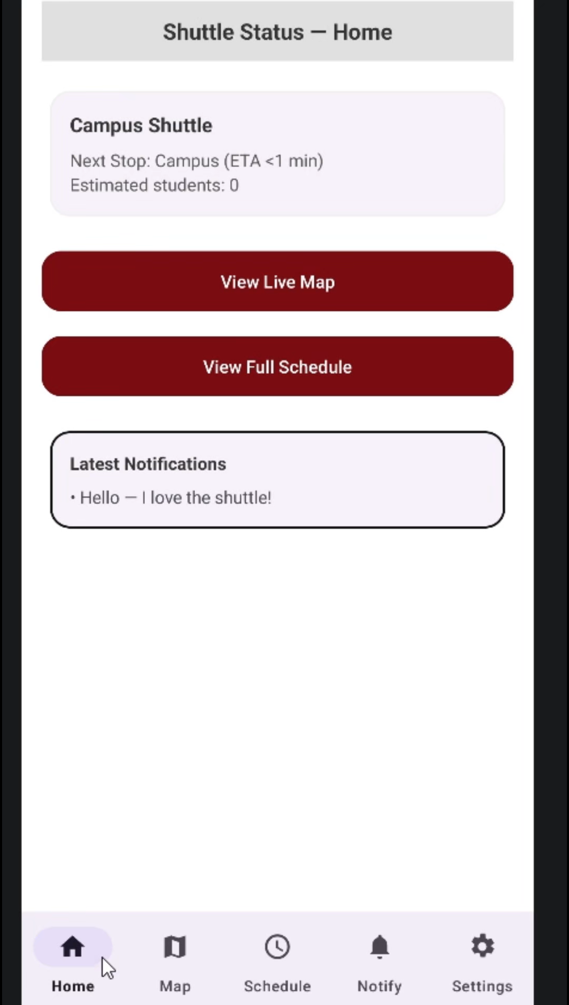



Finalized Student Side

Slide 4
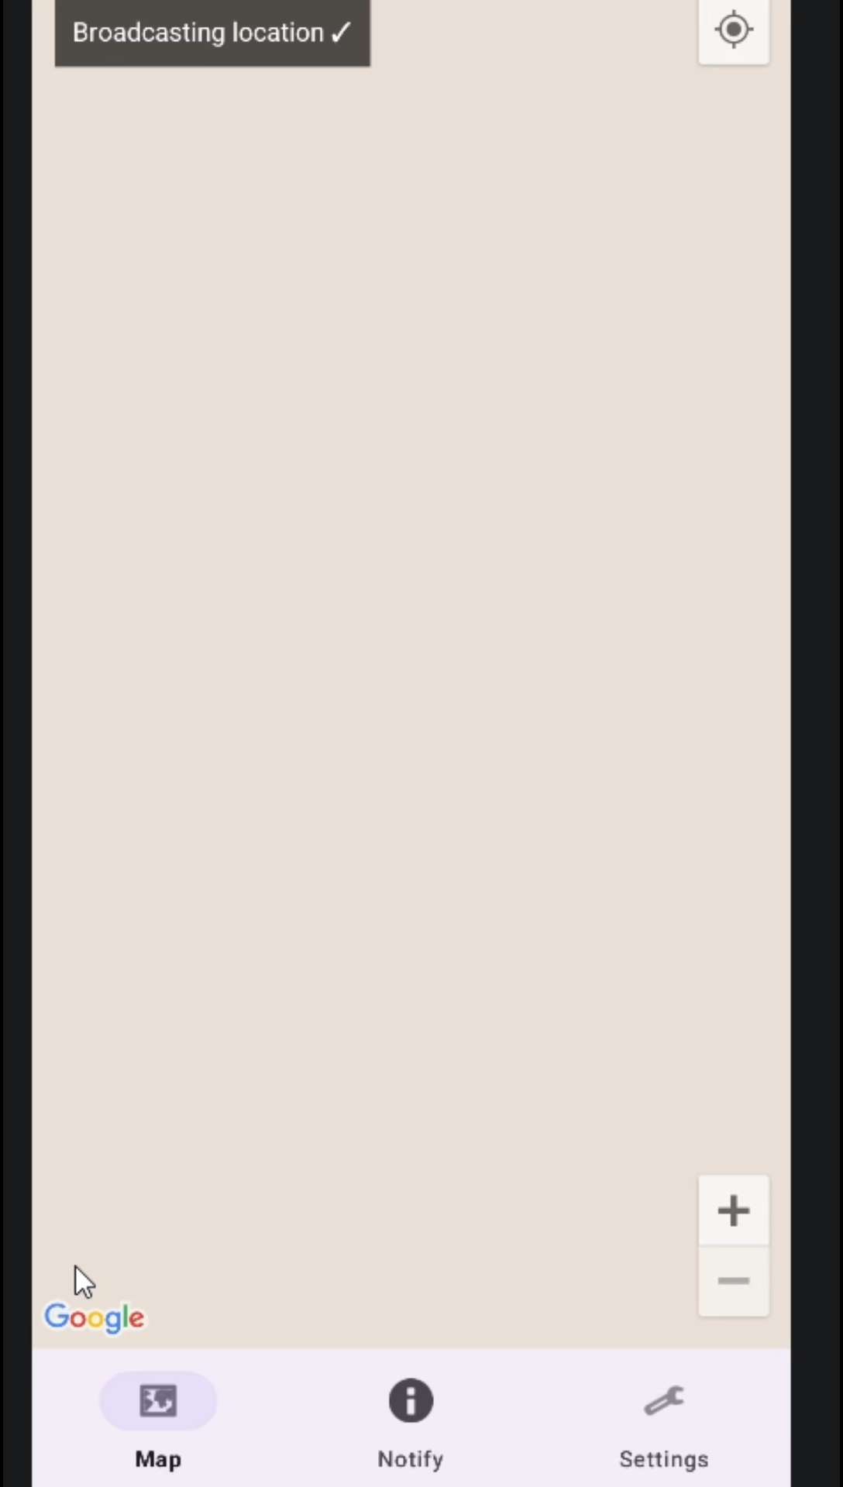
Finalized Driver Side

Slide 5
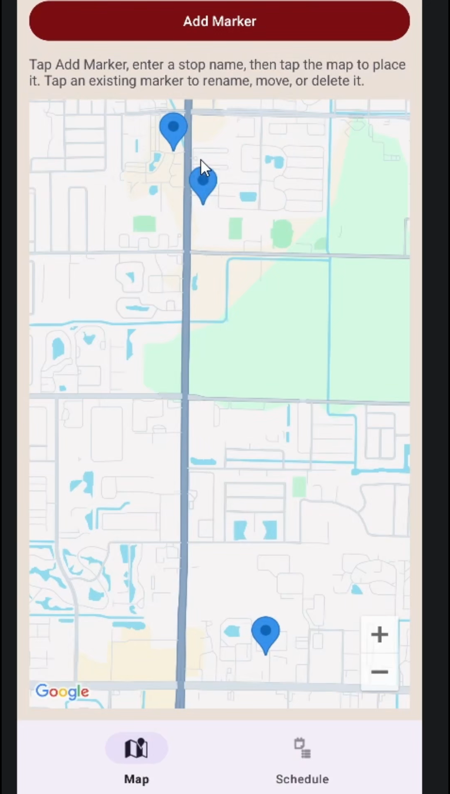
Finalized Manager Side

Slide 6

Testing + Results
Testing (Emulator/Phone, Now w/Manager Side & Updated Features):
  Map
  Tracking
  UI
  Notifications
Results:
Map: 100%
Tracking: 100%
UI: 100%
Notifications: 100%

Slide 7

User/Developer Manual
Both in one Manual
Images
Step by Step
Describes all features
Examples scenarios to try out.

Slide 8

Demo Video

Slide 9
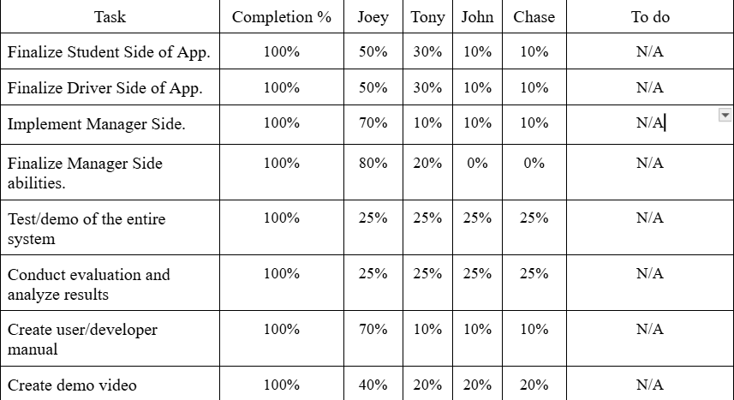


Milestone 6 Progress

Slide 10
Lessons Learned
Cross Platform
Backend Service
API Key
Development Length
First App

Slide 11






QUESTIONS?
Visit our website
https://yanarex.github.io/shuttle-app-website/

